Slide 1
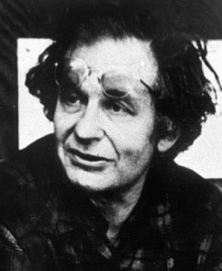
Lawrence Kohlberg – Moral Development
Kohlberg’s stages of moral development:
Theory inspired by Jean Piaget
Method - moral dilemmas (Heinz) to investigate children’s reasoning.
Six stages - concerned with justice.
Not what should be done but reasoning used to justify the response.
Lawrence Kohlberg (1927-1987)

Slide 2
Lawrence Kohlberg – Moral Development
Study
10, 13 and 16 year old boys
Different facets of morality examined:
Value of life and property
Meaning of rules and laws
Value of honesty
Upholding agreements

Slide 3
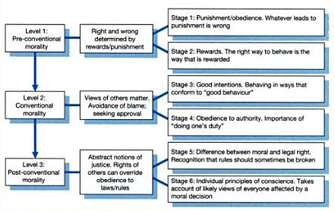
Lawrence Kohlberg – Moral Development

Slide 4
Lawrence Kohlberg – Moral Development
The Heinz dilemma:
A woman was near death from a special kind of cancer. There was one drug that the doctors thought might save her. It was a form of radium that a druggist in the same town had recently discovered. The drug was expensive to make, but the druggist was charging ten times what the drug cost him to produce. He paid $200 for the radium and charged $2,000 for a small dose of the drug. The sick woman's husband, Heinz, went to everyone he knew to borrow the money, but he could only get together about $1,000 which is half of what it cost. He told the druggist that his wife was dying and asked him to sell it cheaper or let him pay later. But the druggist said: "No, I discovered the drug and I'm going to make money from it." So Heinz got desperate and broke into the man's store to steal the drug for his wife.
Should Heinz have broken into the store to steal the drug for his wife? Why or why not?

Slide 5

Lawrence Kohlberg – Moral Development
Stage one (punishment & obedience):
Heinz should not steal the drug
He will be put in prison
Which means he’s a mean bad person.
Or:
Heinz should steal the drug
it is only worth $200
Heinz had even offered to pay & wouldn’t steal anything else.

Slide 6

Lawrence Kohlberg – Moral Development
Stage two (reward & self-interest):
Heinz should not steal the drug
Prison is awful a jail cell is worse than his wife's death.
Or:
Heinz should steal the drug
he will be much happier if he saves his wife

Slide 7
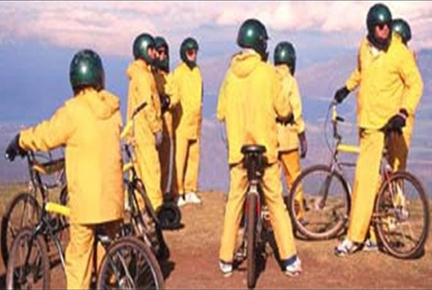
Lawrence Kohlberg – Moral Development
Stage three (conformity – good-boy/nice girl ):
Heinz should not steal the drug
Stealing is bad & he’s not a criminal
He tried without breaking the law, you can’t blame him.
Or:
Heinz should steal the drug
His wife expects it;
He wants to be a good husband.

Slide 8
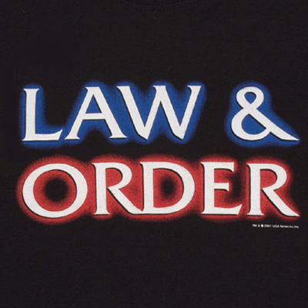
Lawrence Kohlberg – Moral Development
Stage four (law-and-order):
Heinz should not steal the drug
the law prohibits stealing it’s illegal.
Or: Heinz should steal the drug
He should take the punishment for the crime & pay the druggist
Actions have their consequences.

Slide 9

Lawrence Kohlberg – Moral Development
Stage five (human rights):
Heinz should not steal the drug
The scientist has a right to fair compensation.
His wife’s illness it does not make his actions right.
Or:
Heinz should steal the drug
Everyone has a right to choose life, regardless of the law.

Slide 10

Lawrence Kohlberg – Moral Development
Stage six (universal human ethics):
Heinz should not steal the drug
Others may need the drug just as badly & their lives are equally significant.
Or:
Heinz should steal the drug
Saving a human life is a more fundamental value than the property rights of another person.

Slide 11

Lawrence Kohlberg – Moral Development
Discussion:
Cognitive development influences moral reasoning.
From self-centred to other centred – compliment’s Piaget.
From social compliance to universal principles demanded by individual conscience
Do all achieve this?
A cultural ideal based in a
western philosophical tradition?

Slide 12
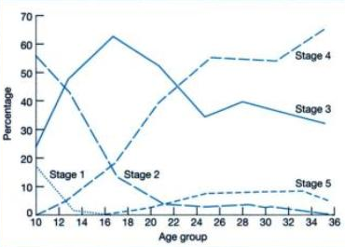
Lawrence Kohlberg – Moral Development
Evaluation:
Colby et al (1983) 20 year longitudinal study of 58 American males who progressed as predicted through levels 1 – 4.
10-16 yrs stages 1 & 2 decreased & stage 3 & 4 increased.
But only 10% at stage 5
in their 30’s.
No evidence of stage 6.

Slide 13

Lawrence Kohlberg – Moral Development
Snarey (1985) meta-analysis of 44 studies from 27 cultures.
Supports Kohlberg prediction through levels 1 – 4.
Same order & time.
Stage 5 more in western cultures than rural or village cultures.
Reflection of western individualism.

Slide 14

Lawrence Kohlberg – Moral Development
Isawa (1992)
Cross cultural analysis Japan & USA
Similar stages of moral reasoning
But cultural differences
USA participants favoured Heinz stealing to preserve his wife’s life.
Japanese participants thought he should not to preserve a clean & pure life.

Slide 15

Lawrence Kohlberg – Moral Development
Tomlinson-Keasey & Keasey (1974) investigated links between cognitive & moral development.
Girls of 11 – 12 years at Stage 5 scored well on tests of abstract reasoning – as predicted.
But some failed to show stage 5 moral reasoning.
Abstract reasoning may be a necessary precondition but is not a sufficient explanation of Post – Conventional moral reasoning.

Slide 16

Lawrence Kohlberg – Moral Development
Carol Gilligan (1982) Kohlberg is sex-biased - androcentrism (GK. Andro = man / male)
Kohlberg only interviewed males
Females - stage 3 (interpersonal feelings)
Males - stages 4 and 5 (principles)
Males - rules, rights, & abstract principles - ideal = formal justice.
Females - relationships & compassion - ideal = affiliation not abstract hypothetical dilemmas.
Carol Gilligan (b. 1936)

Slide 17
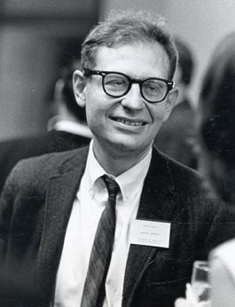
Lawrence Kohlberg – Moral Development
Conclusions:
Strong evidence for children progressing through Kohlberg’s stages as predicted – across cultures
Most people do not go beyond Stage 4.
Difficult to distinguish between stages 5 & 6.
Cultural variations not accounted for.
Gender bias.
Complex & artificial dilemma story.

